Slide 1

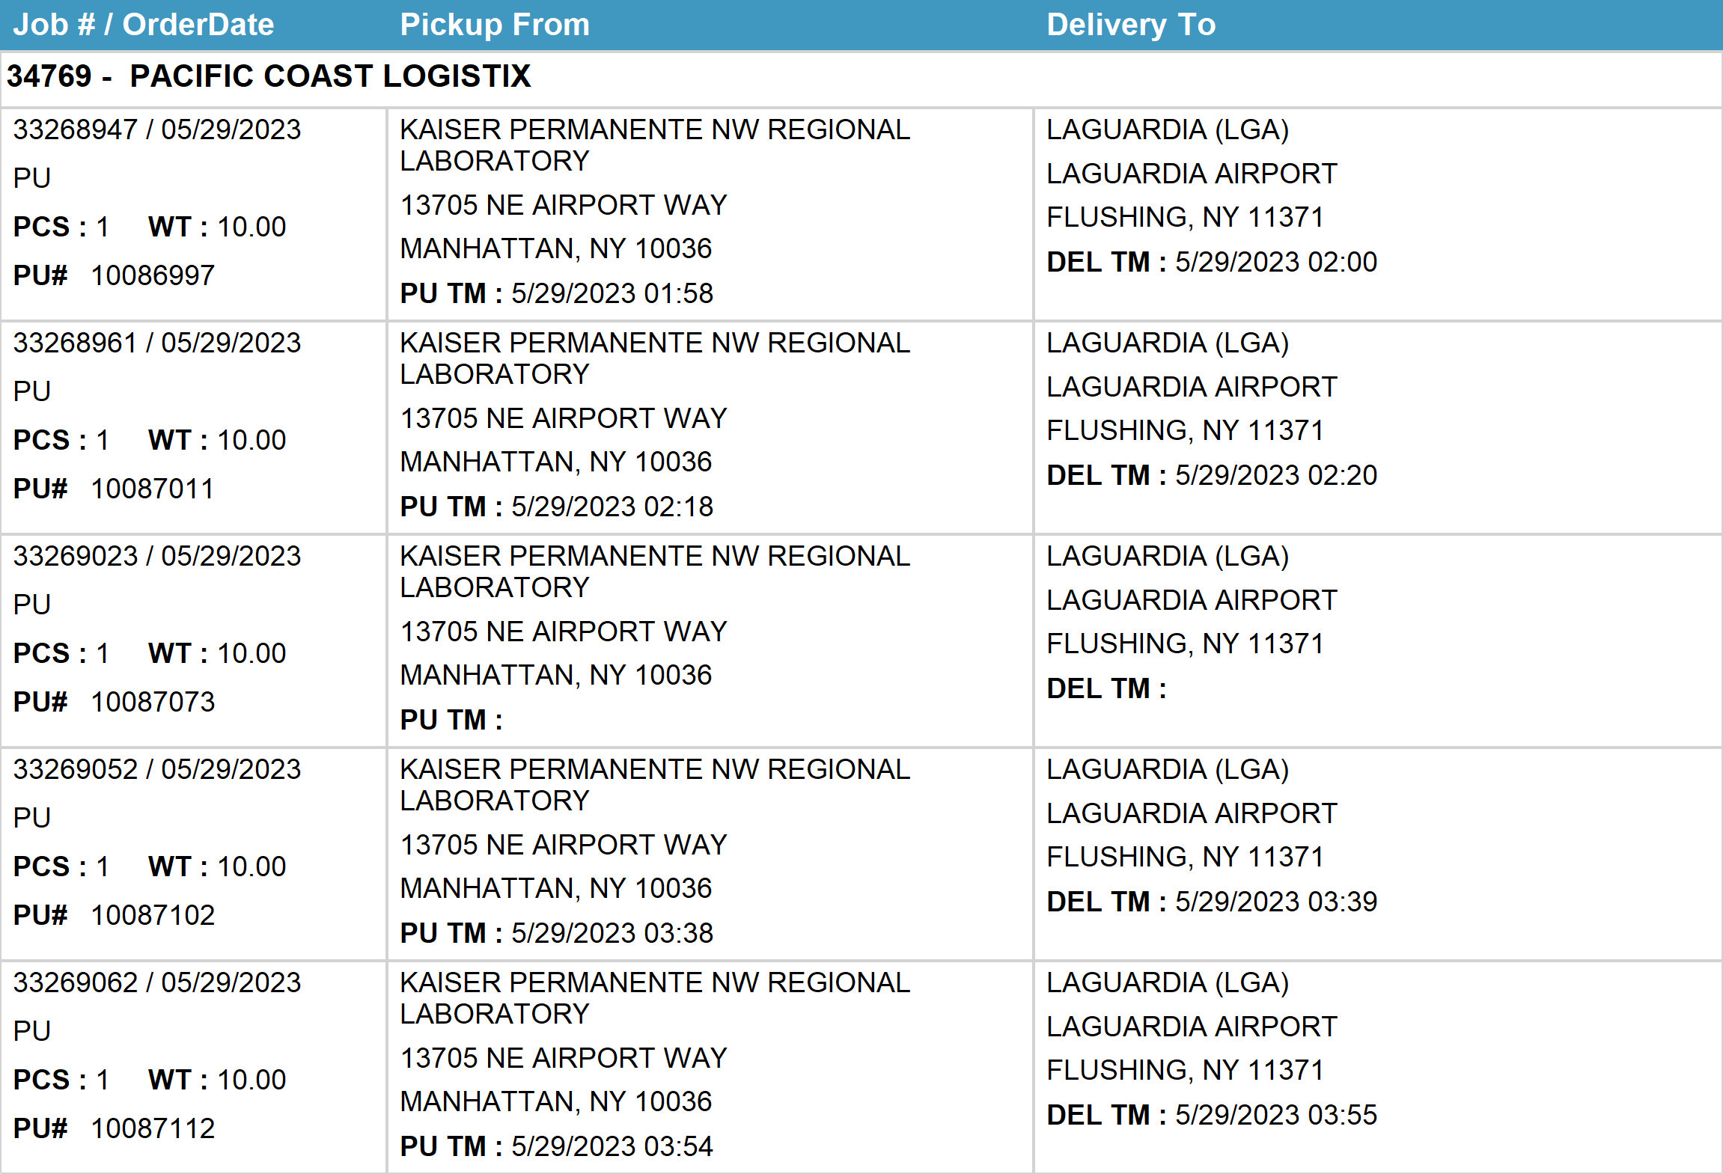
Agent Activity Report
*Data provided should be considered CONFIDENTIAL and PROPRIETARY*
©2011-2023 MNX Global Logistics. All rights reserved.
6/5/2023 2:47 AM
Print User : selenium.automation

Slide 2
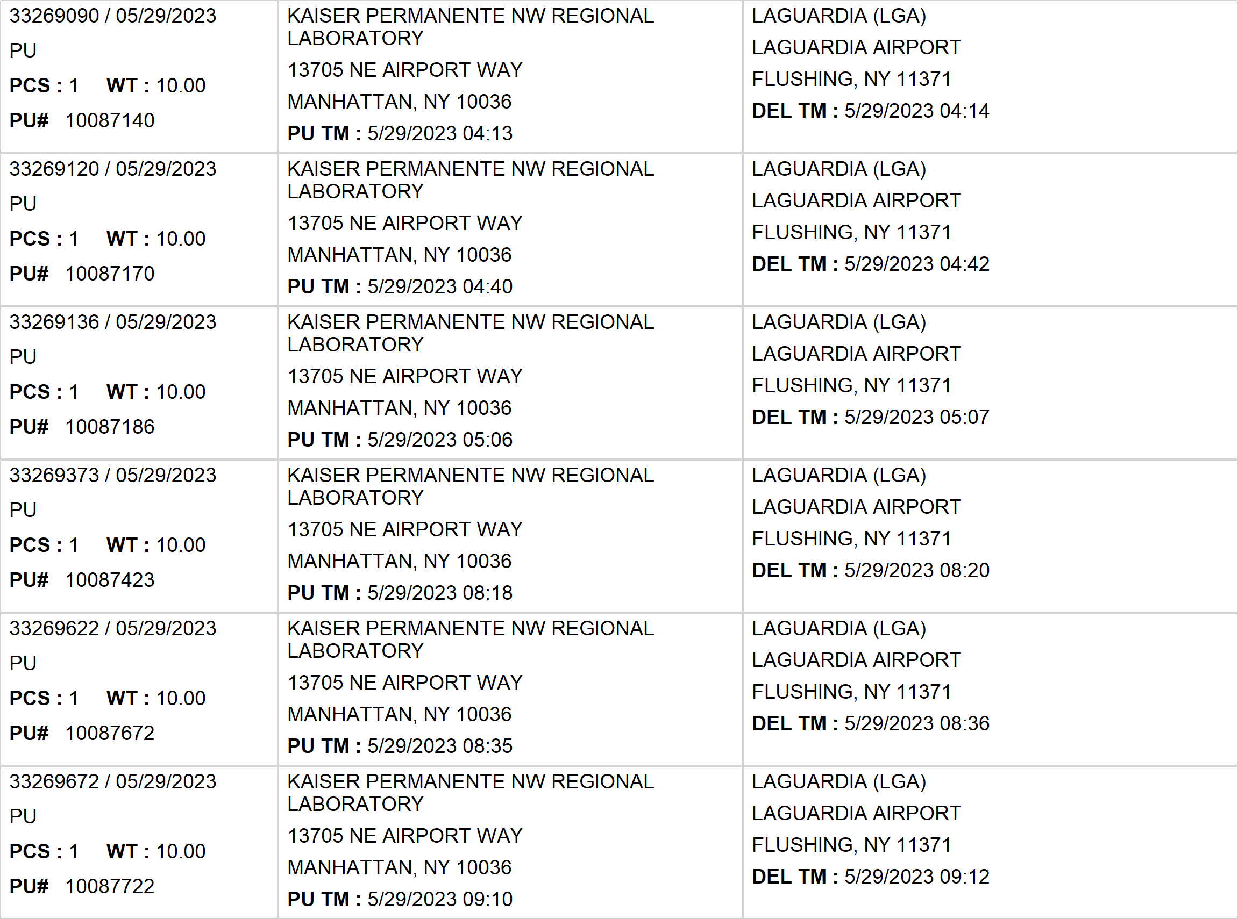
Agent Activity Report
*Data provided should be considered CONFIDENTIAL and PROPRIETARY*
©2011-2023 MNX Global Logistics. All rights reserved.
6/5/2023 2:47 AM
Print User : selenium.automation

Slide 3
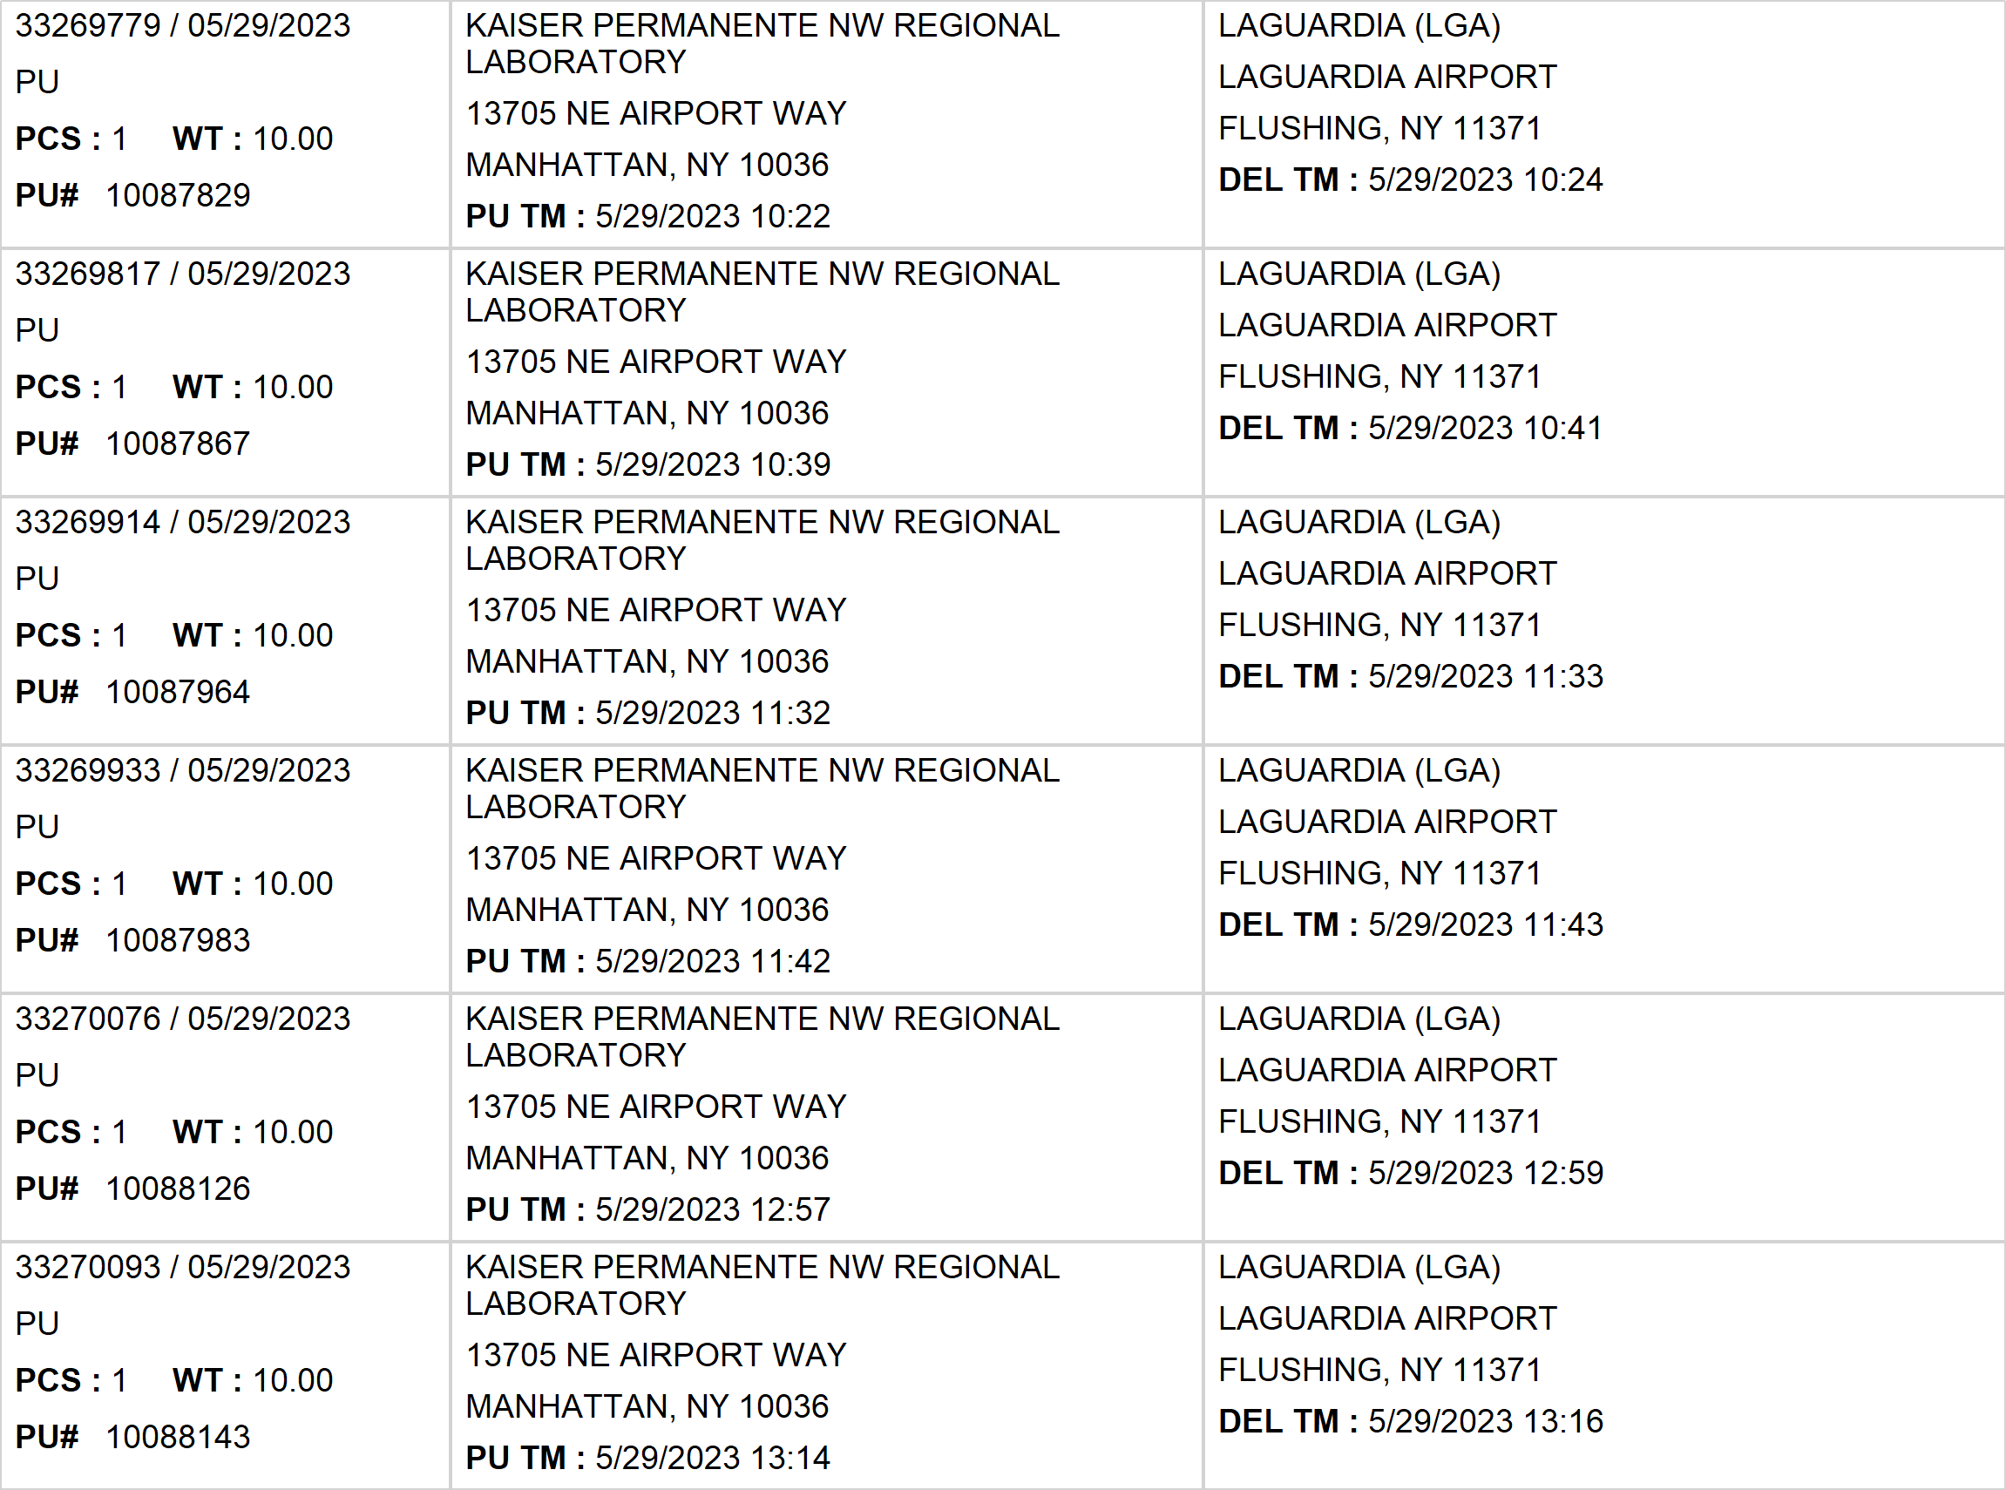
Agent Activity Report
*Data provided should be considered CONFIDENTIAL and PROPRIETARY*
©2011-2023 MNX Global Logistics. All rights reserved.
6/5/2023 2:47 AM
Print User : selenium.automation

Slide 4
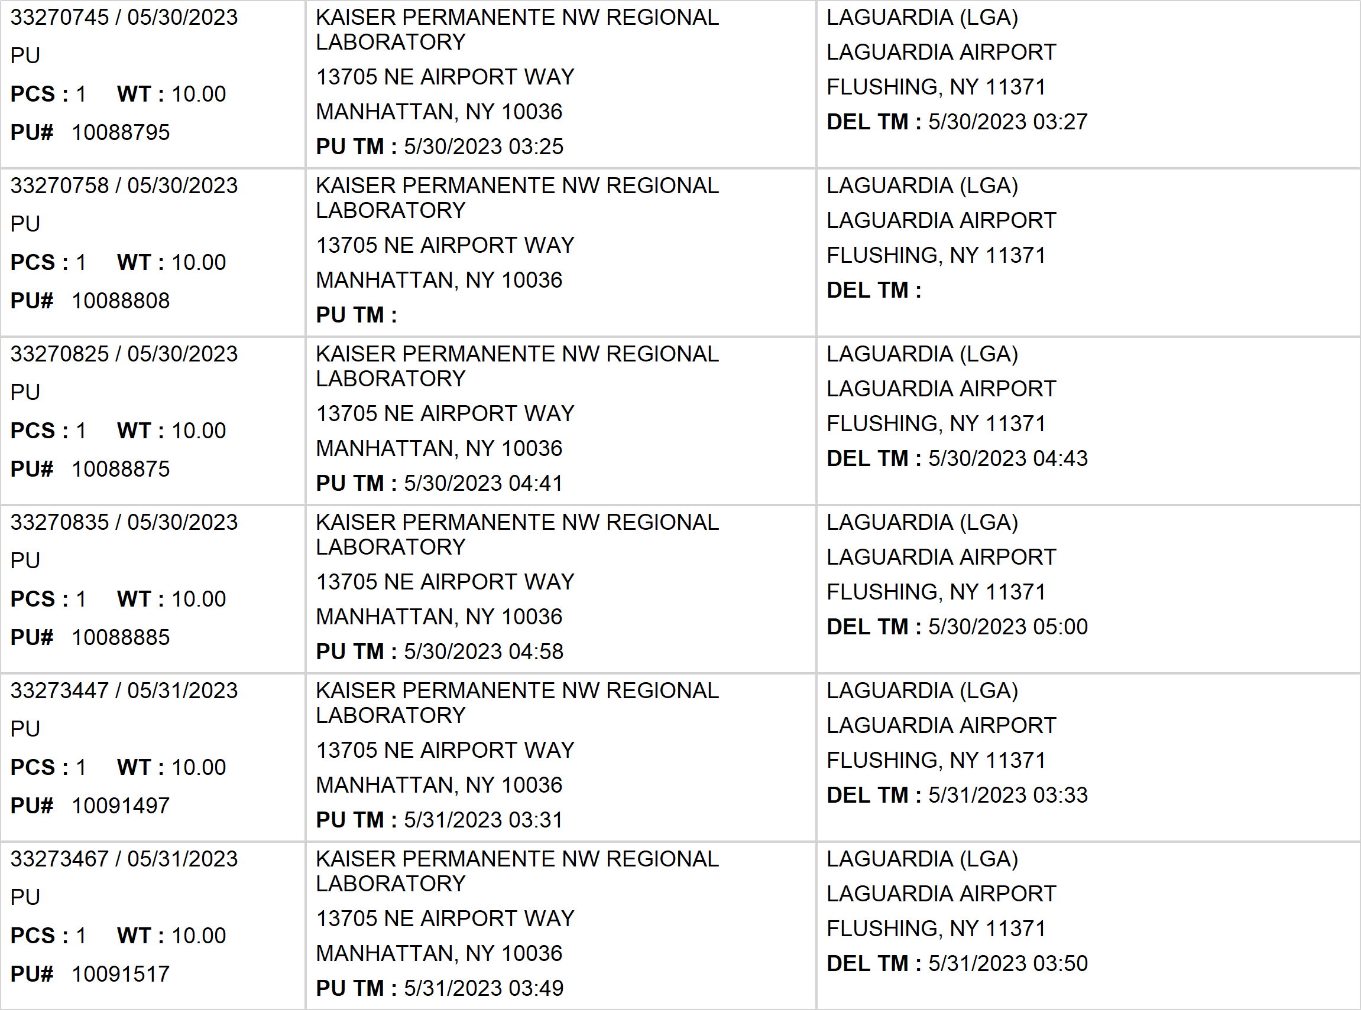
Agent Activity Report
*Data provided should be considered CONFIDENTIAL and PROPRIETARY*
©2011-2023 MNX Global Logistics. All rights reserved.
6/5/2023 2:47 AM
Print User : selenium.automation

Slide 5
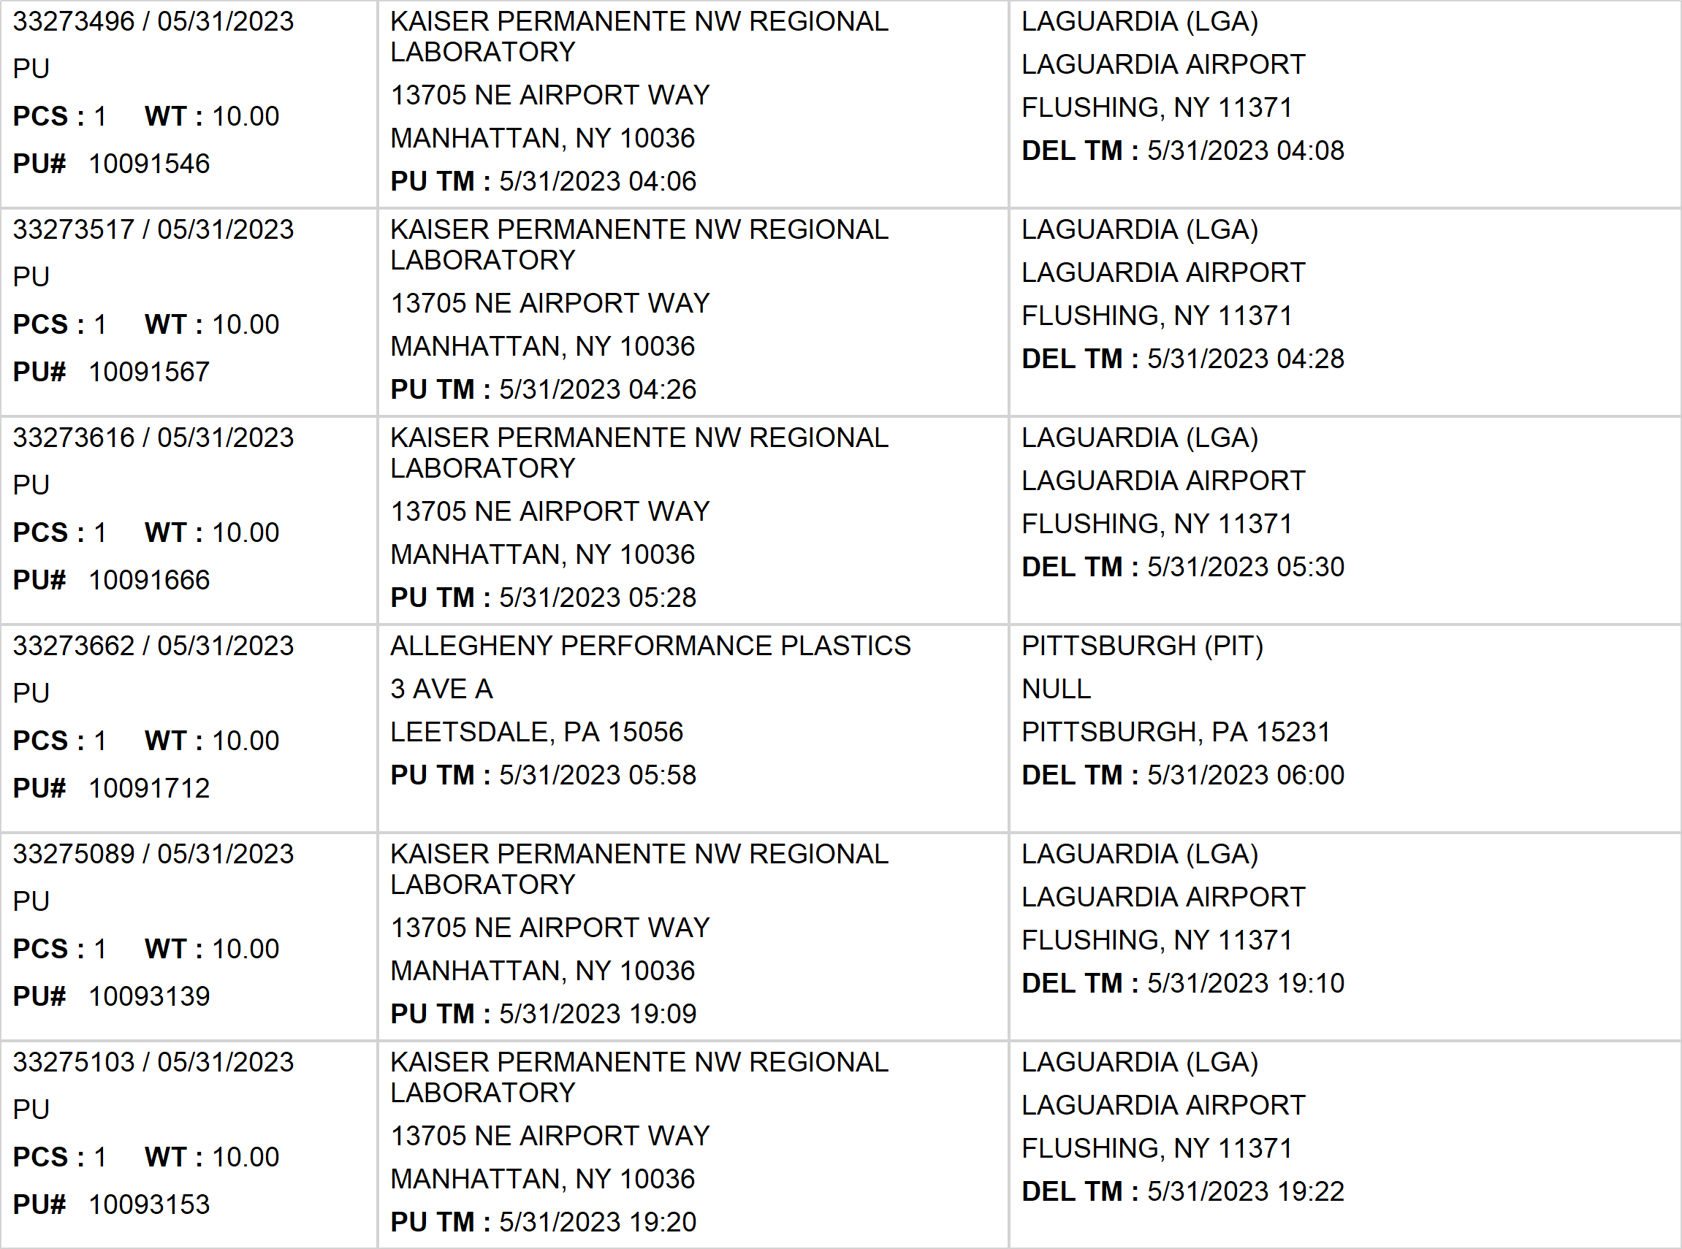
Agent Activity Report
*Data provided should be considered CONFIDENTIAL and PROPRIETARY*
©2011-2023 MNX Global Logistics. All rights reserved.
6/5/2023 2:47 AM
Print User : selenium.automation

Slide 6
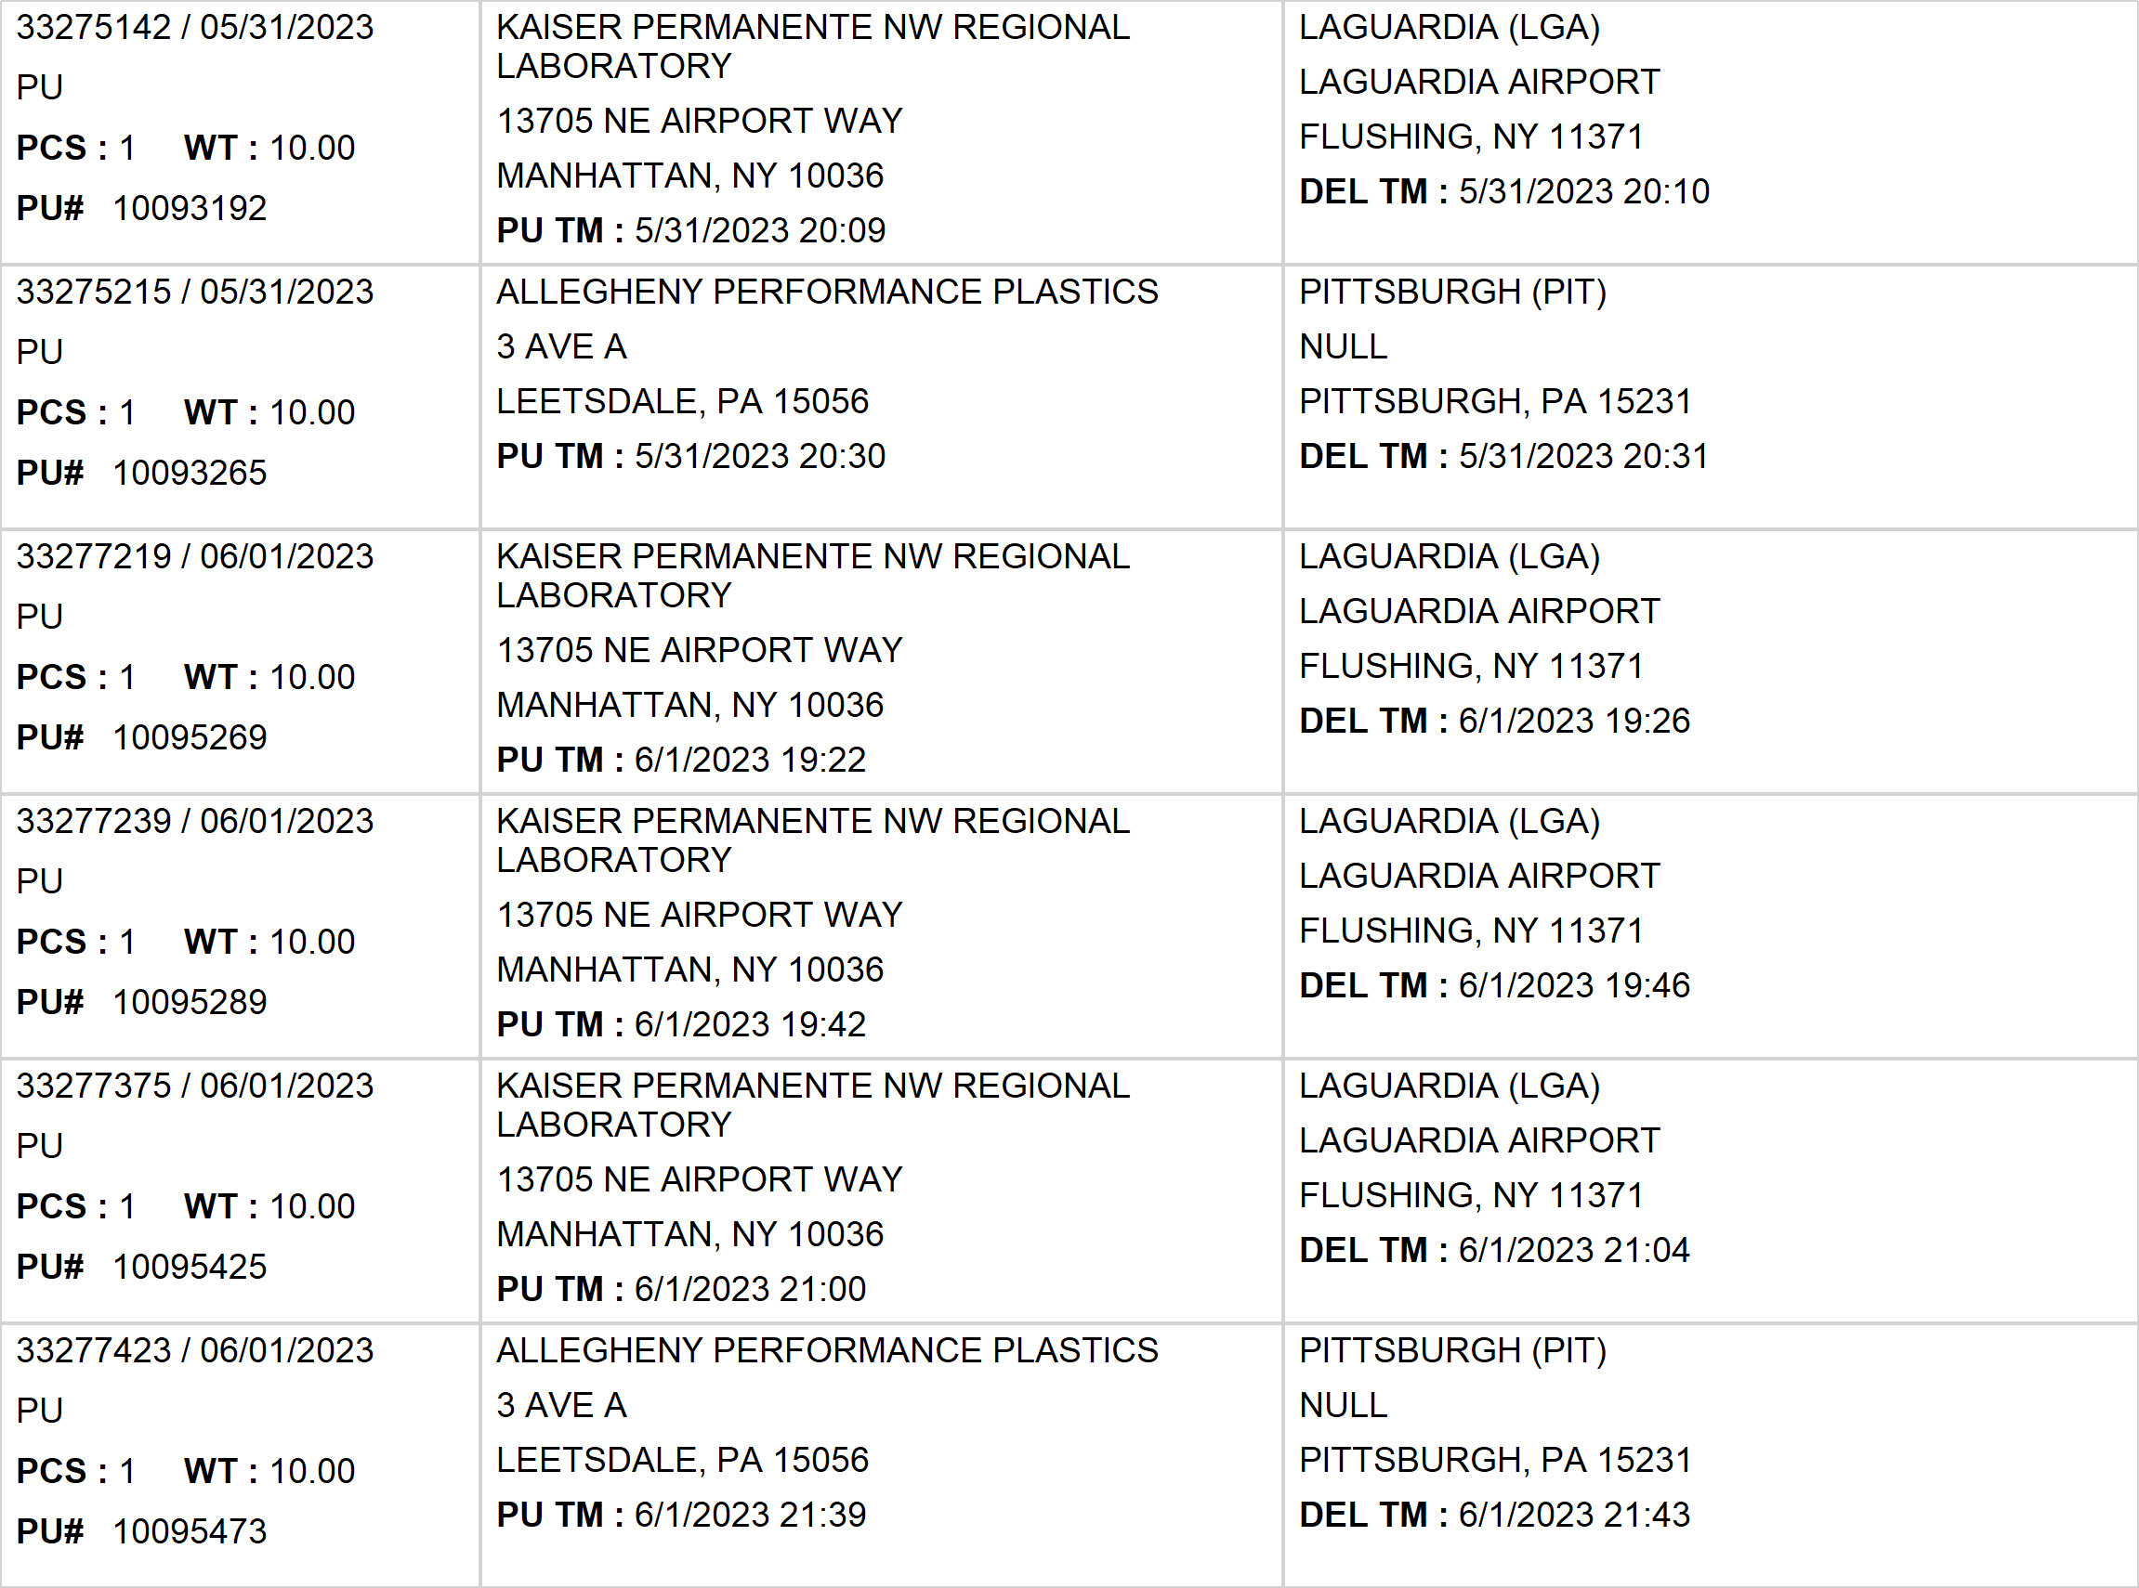
Agent Activity Report
*Data provided should be considered CONFIDENTIAL and PROPRIETARY*
©2011-2023 MNX Global Logistics. All rights reserved.
6/5/2023 2:47 AM
Print User : selenium.automation

Slide 7
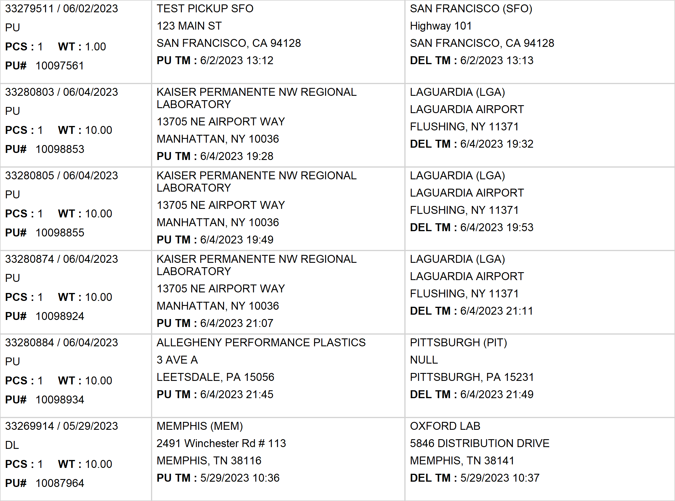
Agent Activity Report
*Data provided should be considered CONFIDENTIAL and PROPRIETARY*
©2011-2023 MNX Global Logistics. All rights reserved.
6/5/2023 2:47 AM
Print User : selenium.automation

Slide 8
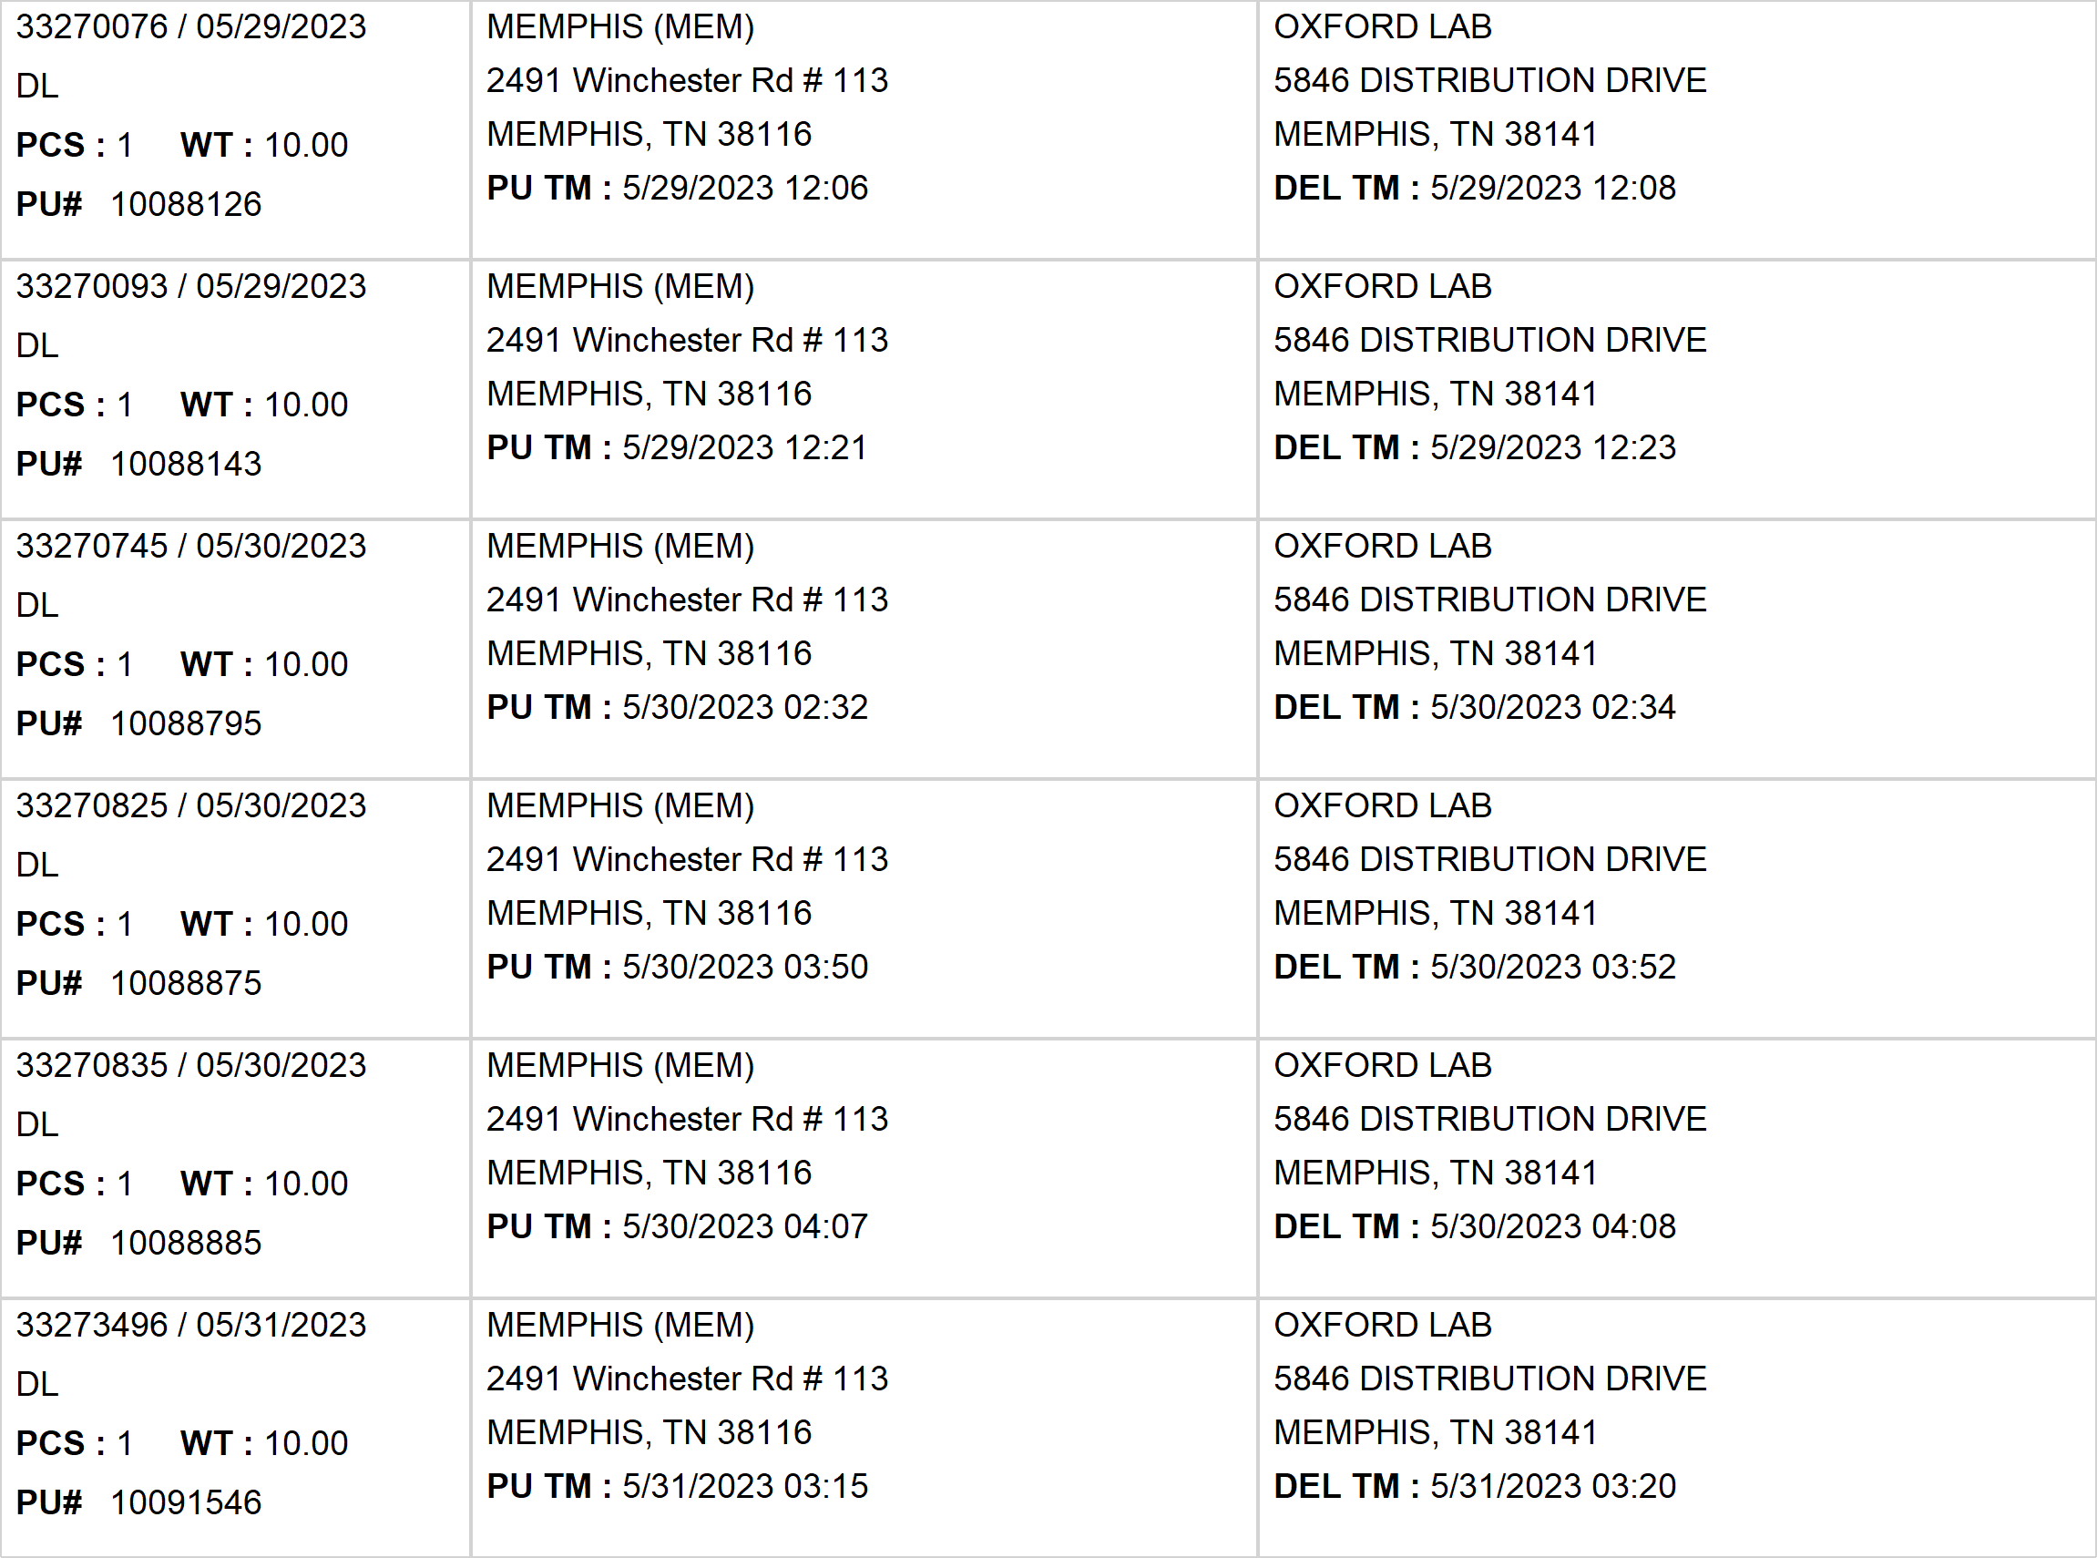
Agent Activity Report
*Data provided should be considered CONFIDENTIAL and PROPRIETARY*
©2011-2023 MNX Global Logistics. All rights reserved.
6/5/2023 2:47 AM
Print User : selenium.automation

Slide 9
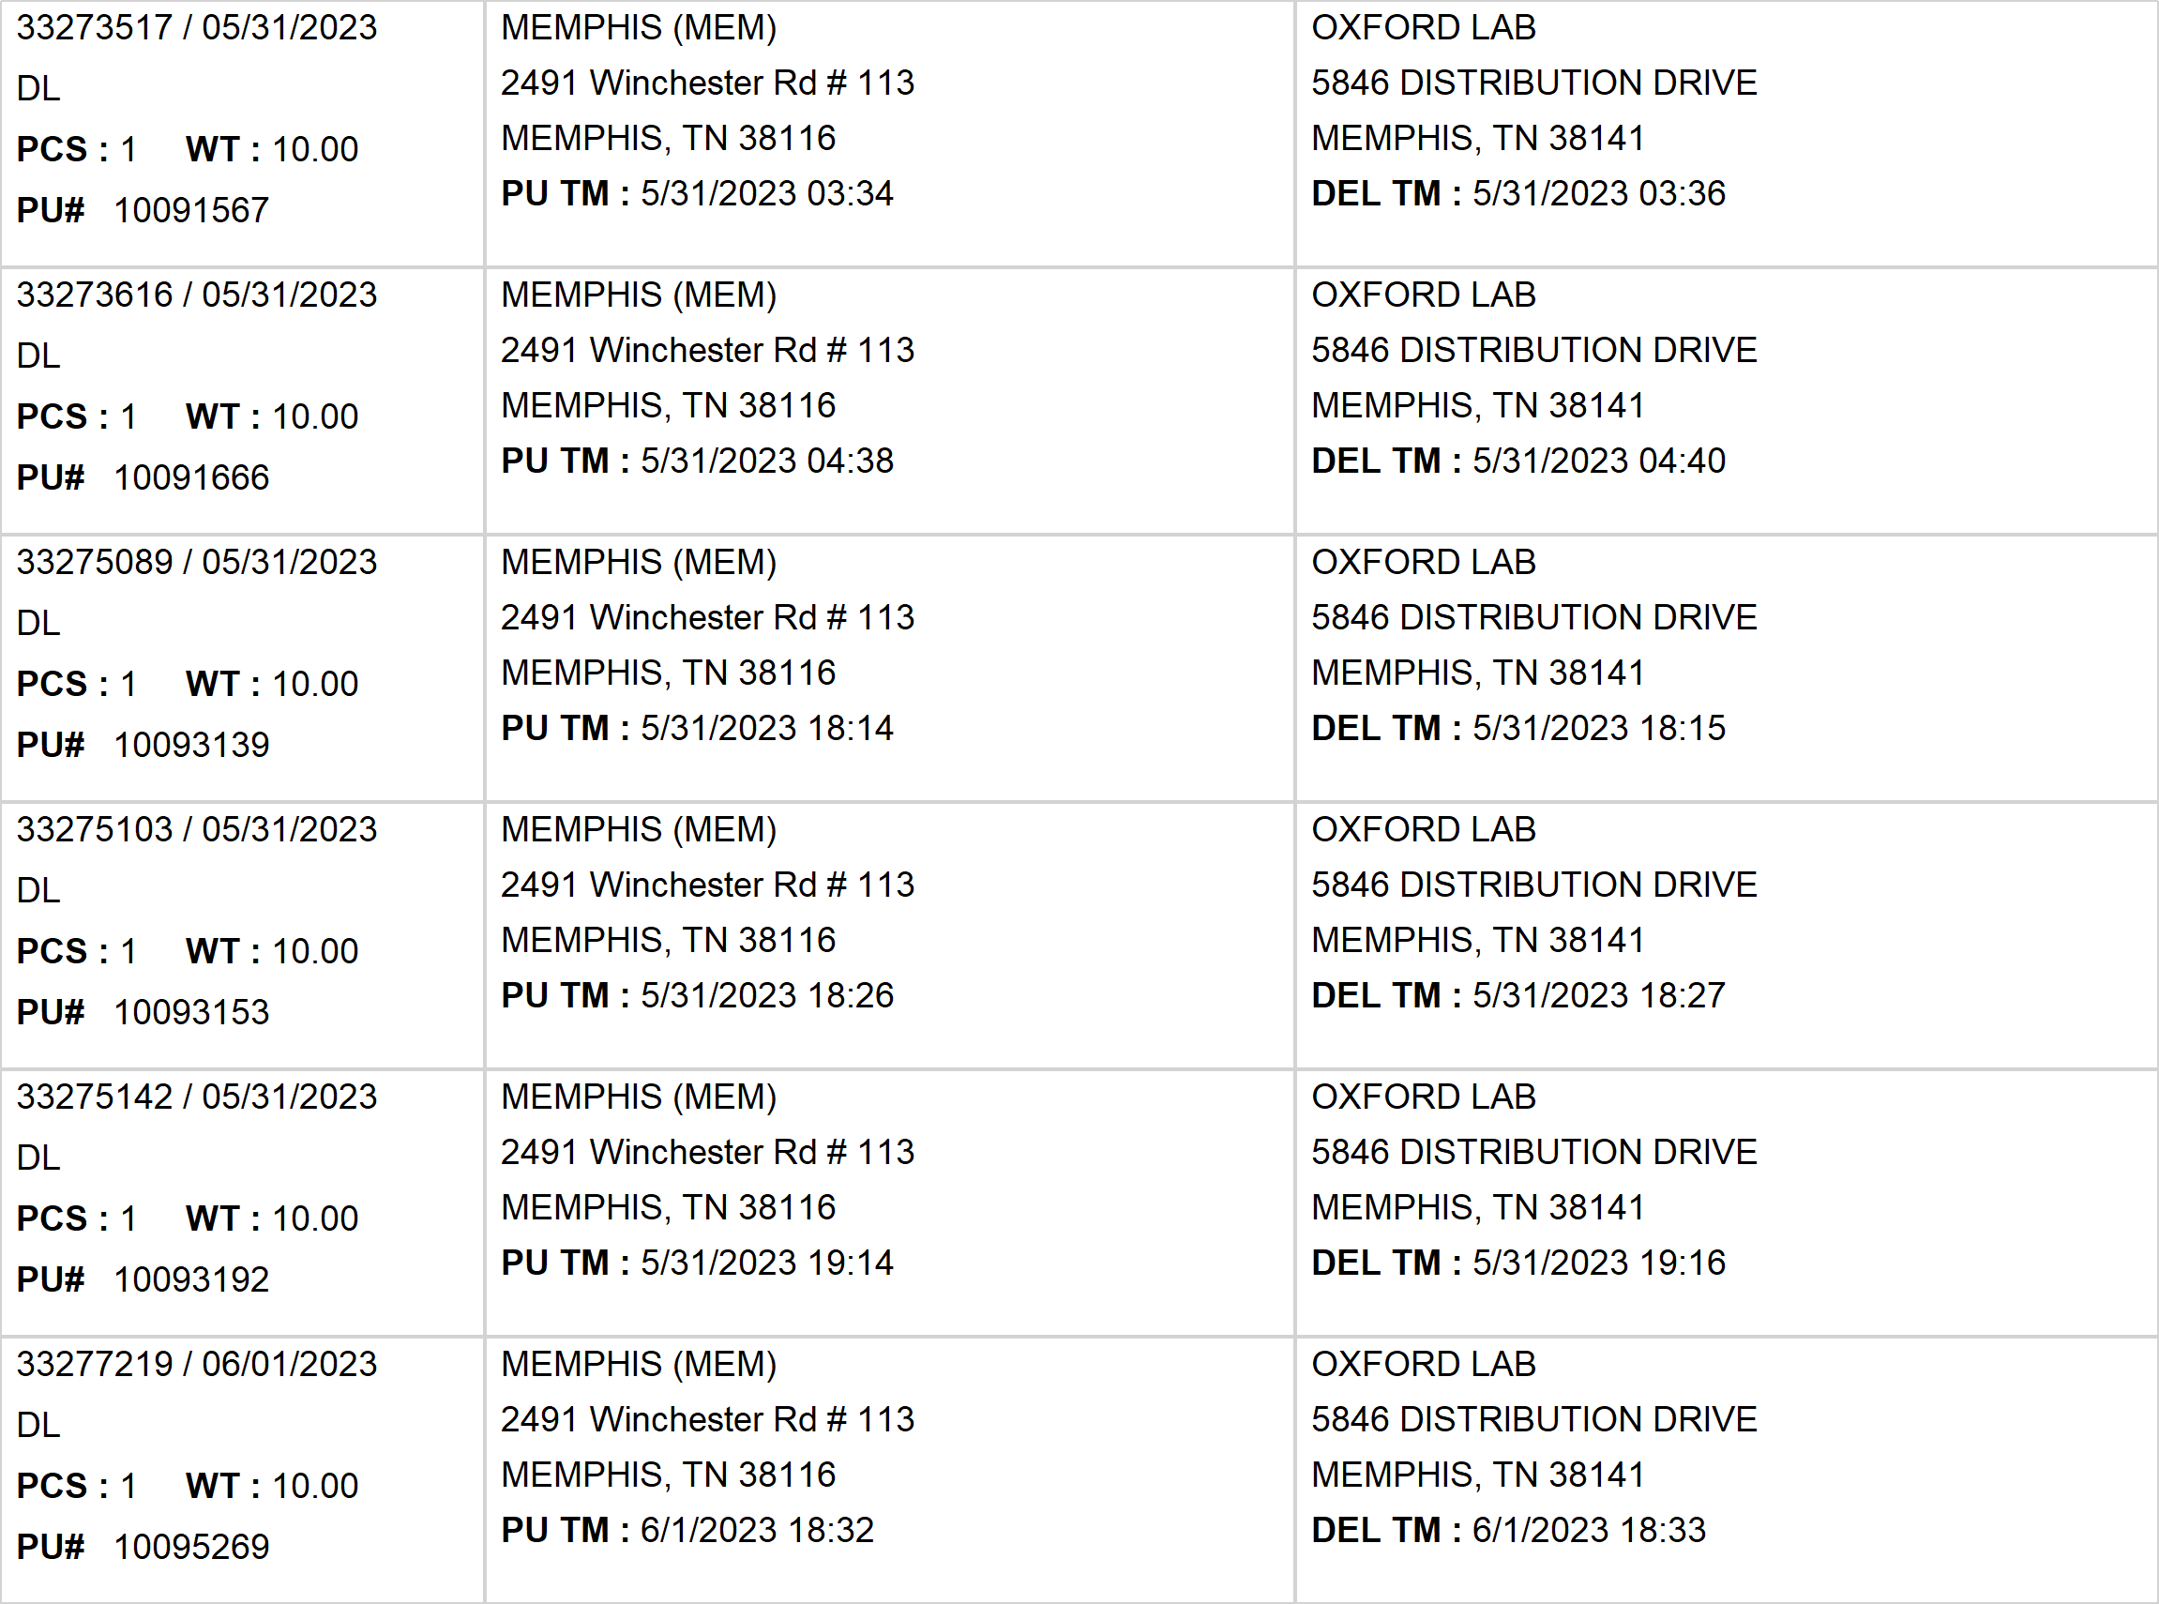
Agent Activity Report
*Data provided should be considered CONFIDENTIAL and PROPRIETARY*
©2011-2023 MNX Global Logistics. All rights reserved.
6/5/2023 2:47 AM
Print User : selenium.automation

Slide 10
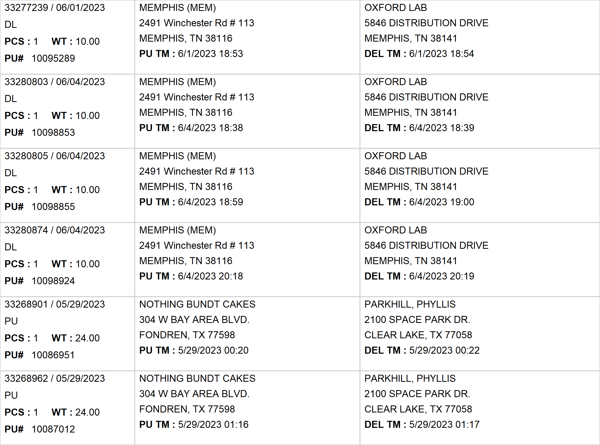
Agent Activity Report
*Data provided should be considered CONFIDENTIAL and PROPRIETARY*
©2011-2023 MNX Global Logistics. All rights reserved.
6/5/2023 2:47 AM
Print User : selenium.automation

Slide 11
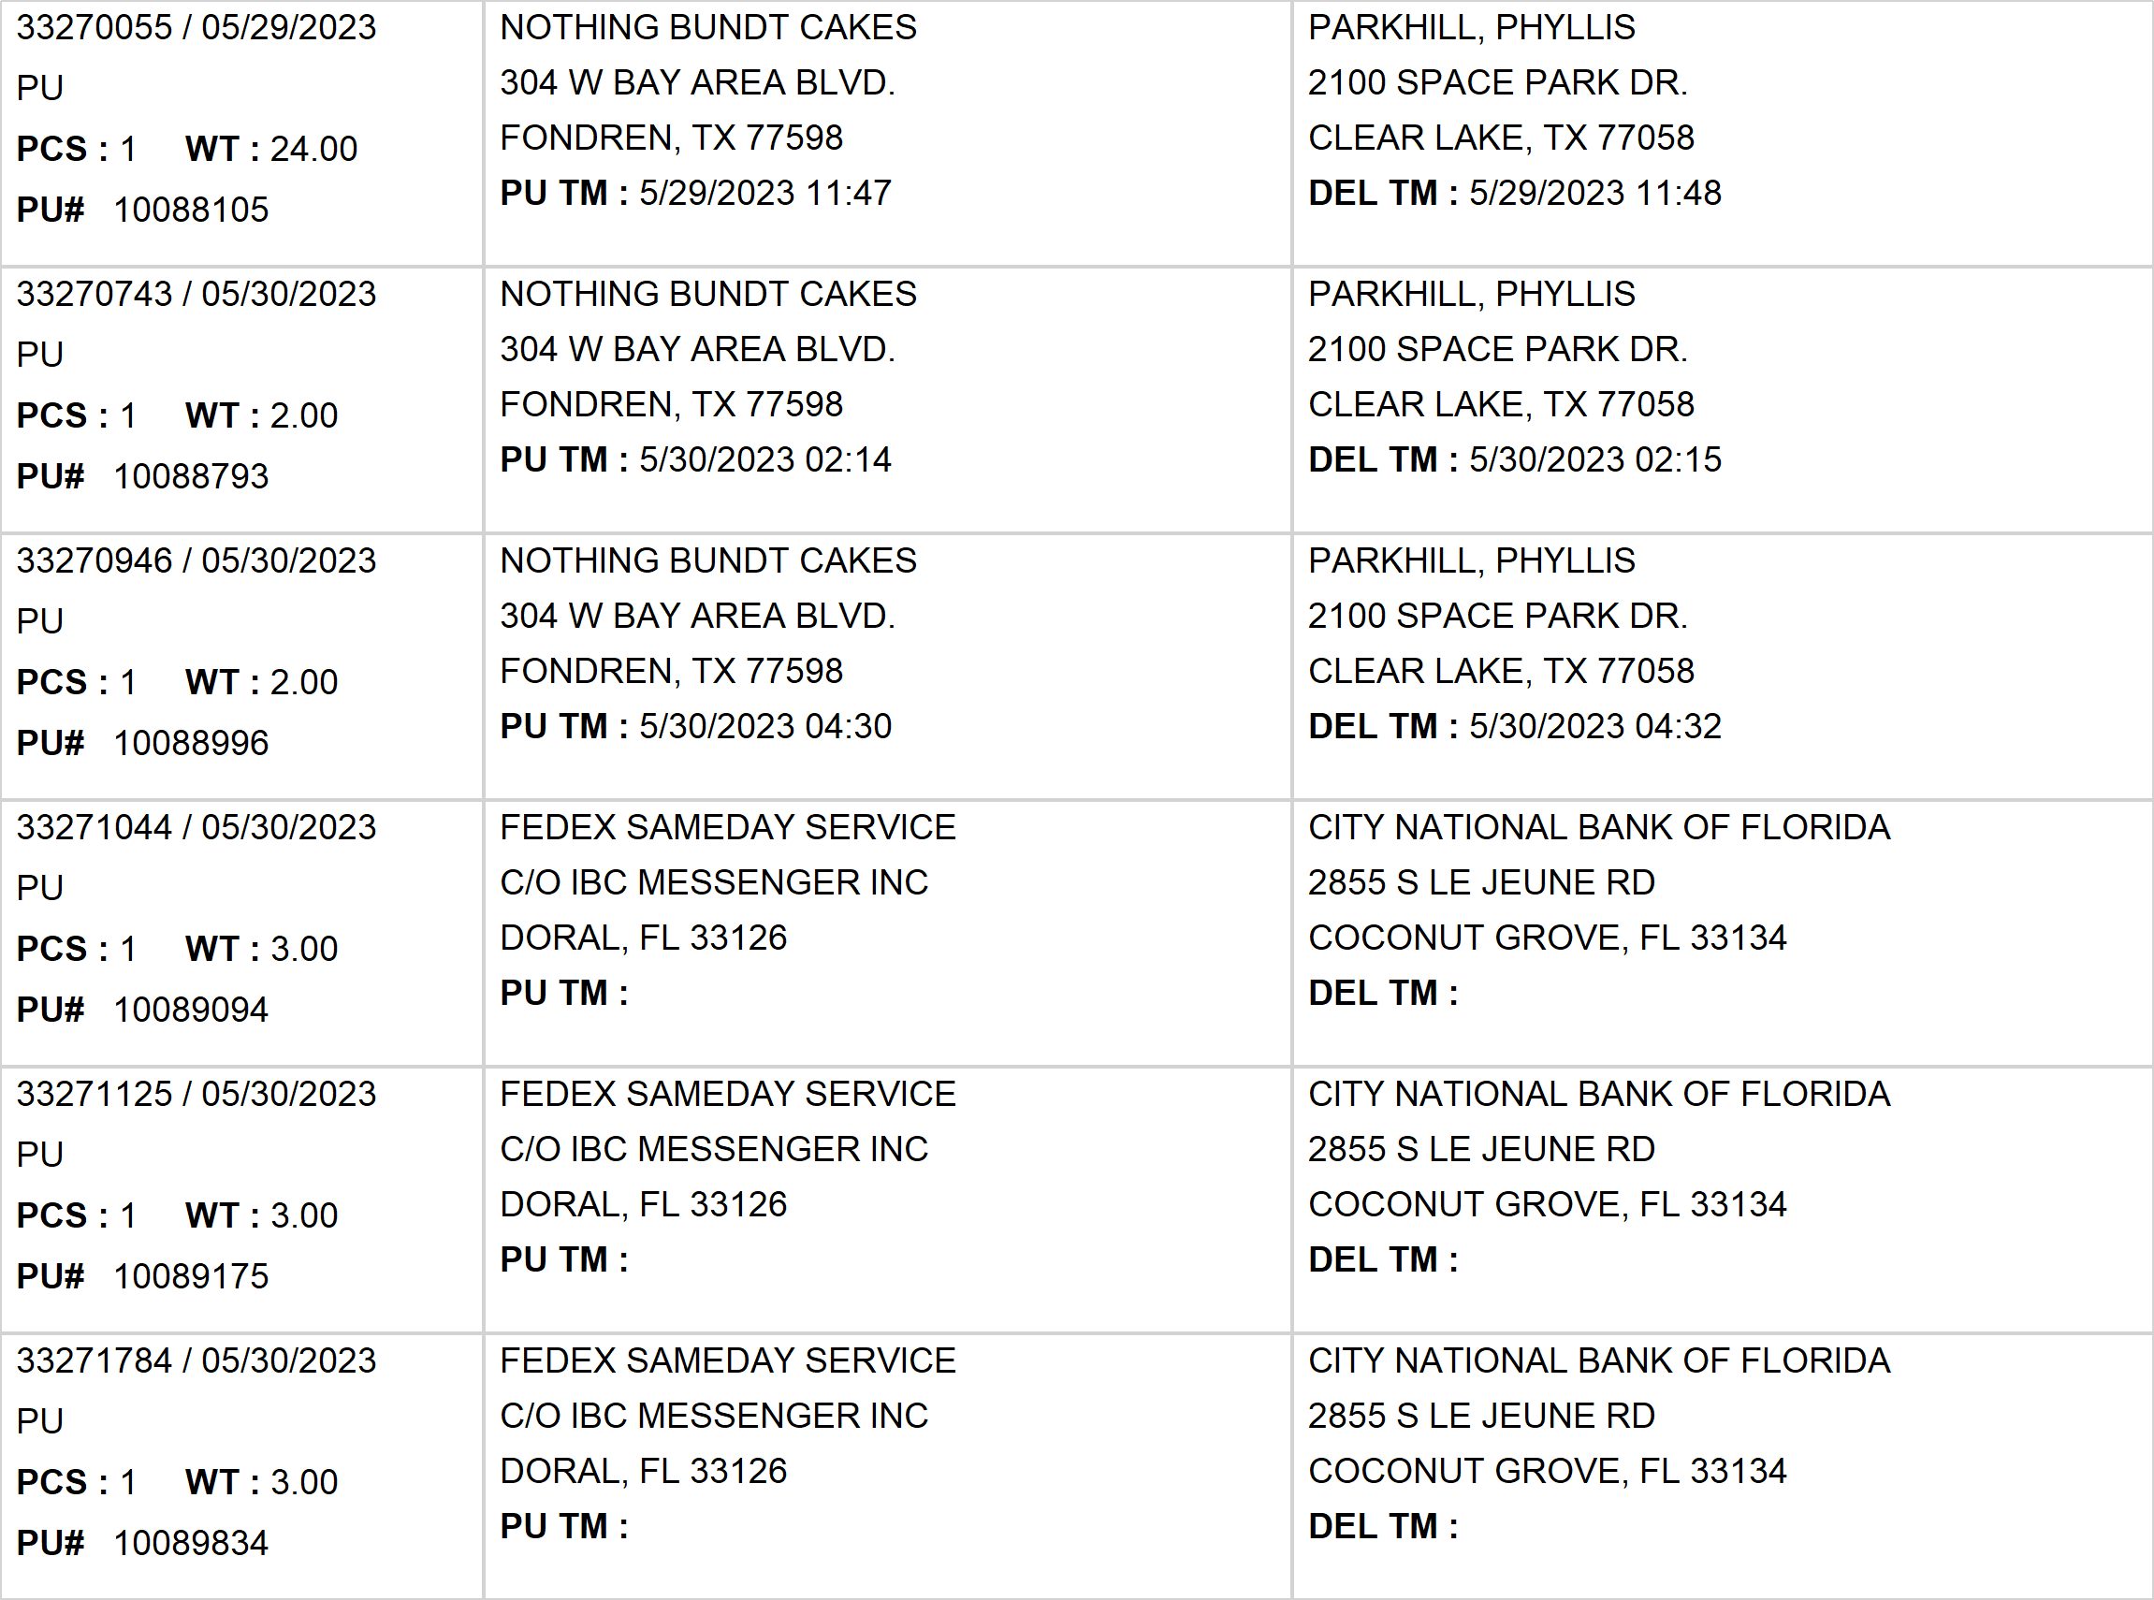
Agent Activity Report
*Data provided should be considered CONFIDENTIAL and PROPRIETARY*
©2011-2023 MNX Global Logistics. All rights reserved.
6/5/2023 2:47 AM
Print User : selenium.automation

Slide 12
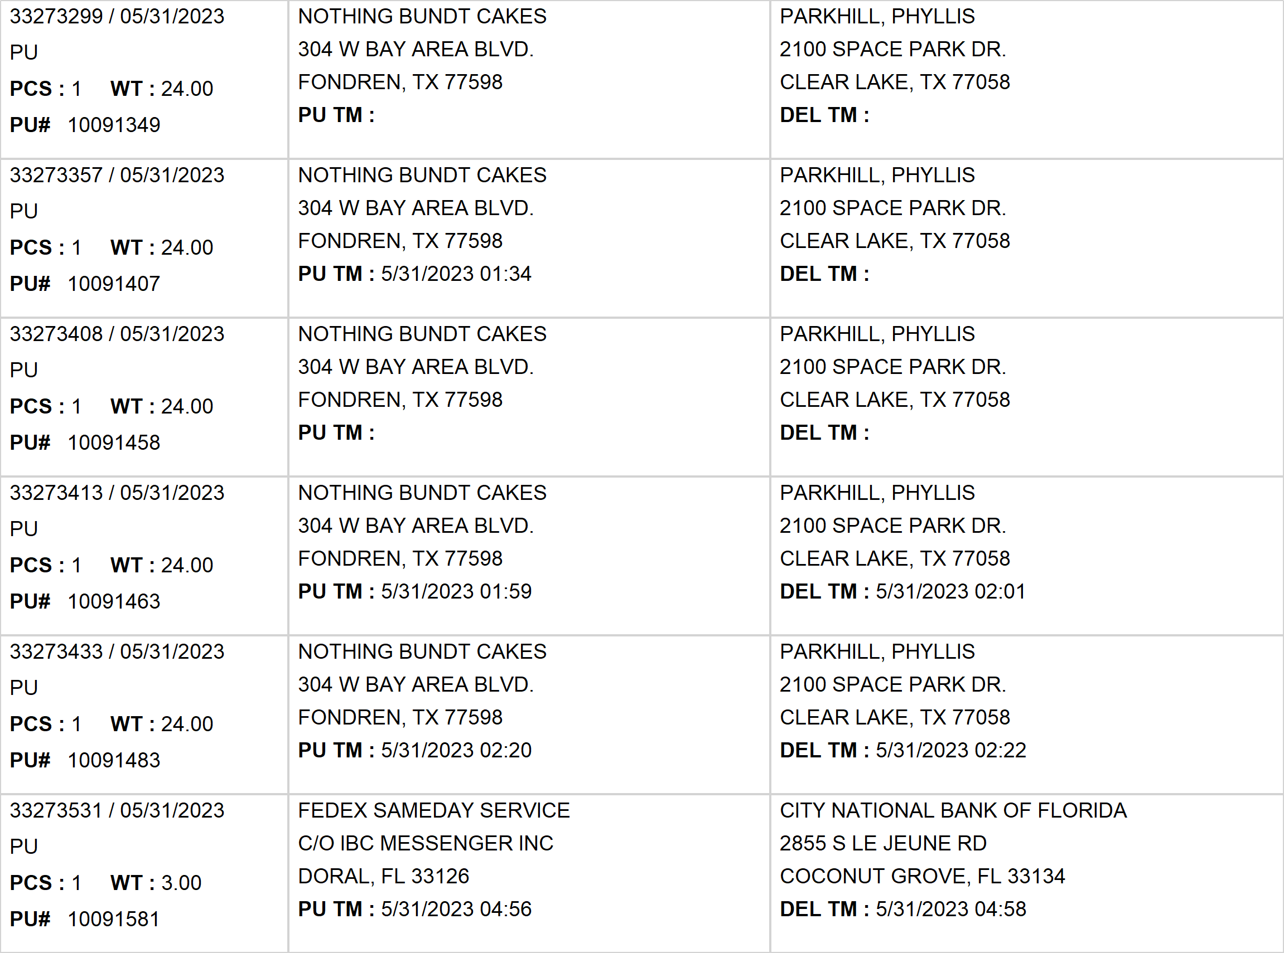
Agent Activity Report
*Data provided should be considered CONFIDENTIAL and PROPRIETARY*
©2011-2023 MNX Global Logistics. All rights reserved.
6/5/2023 2:47 AM
Print User : selenium.automation

Slide 13
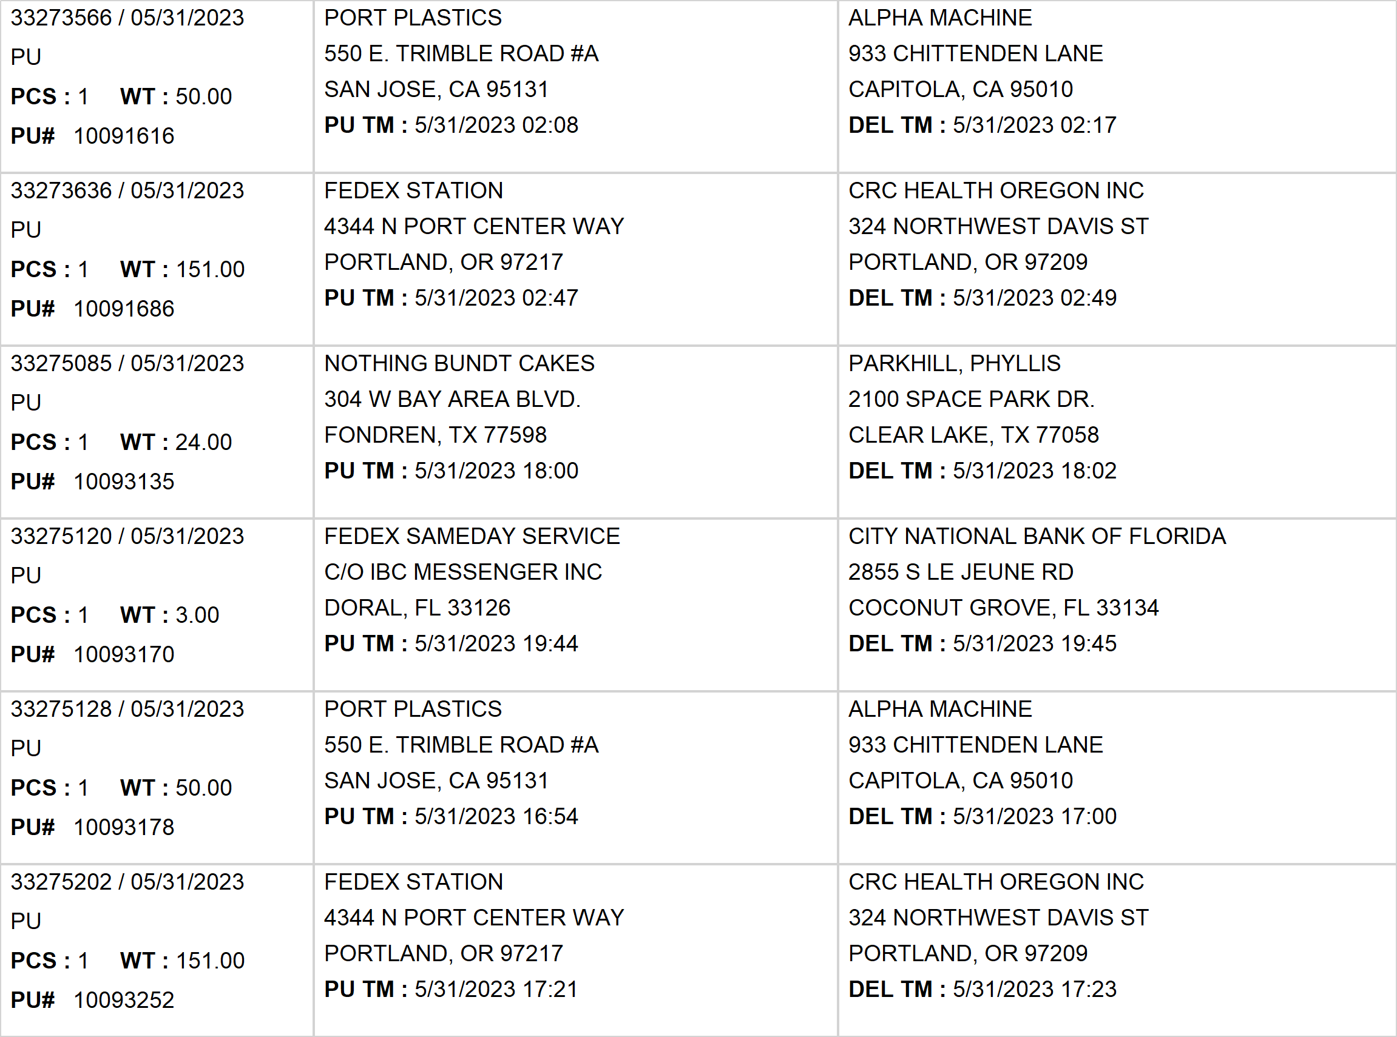
Agent Activity Report
*Data provided should be considered CONFIDENTIAL and PROPRIETARY*
©2011-2023 MNX Global Logistics. All rights reserved.
6/5/2023 2:47 AM
Print User : selenium.automation

Slide 14
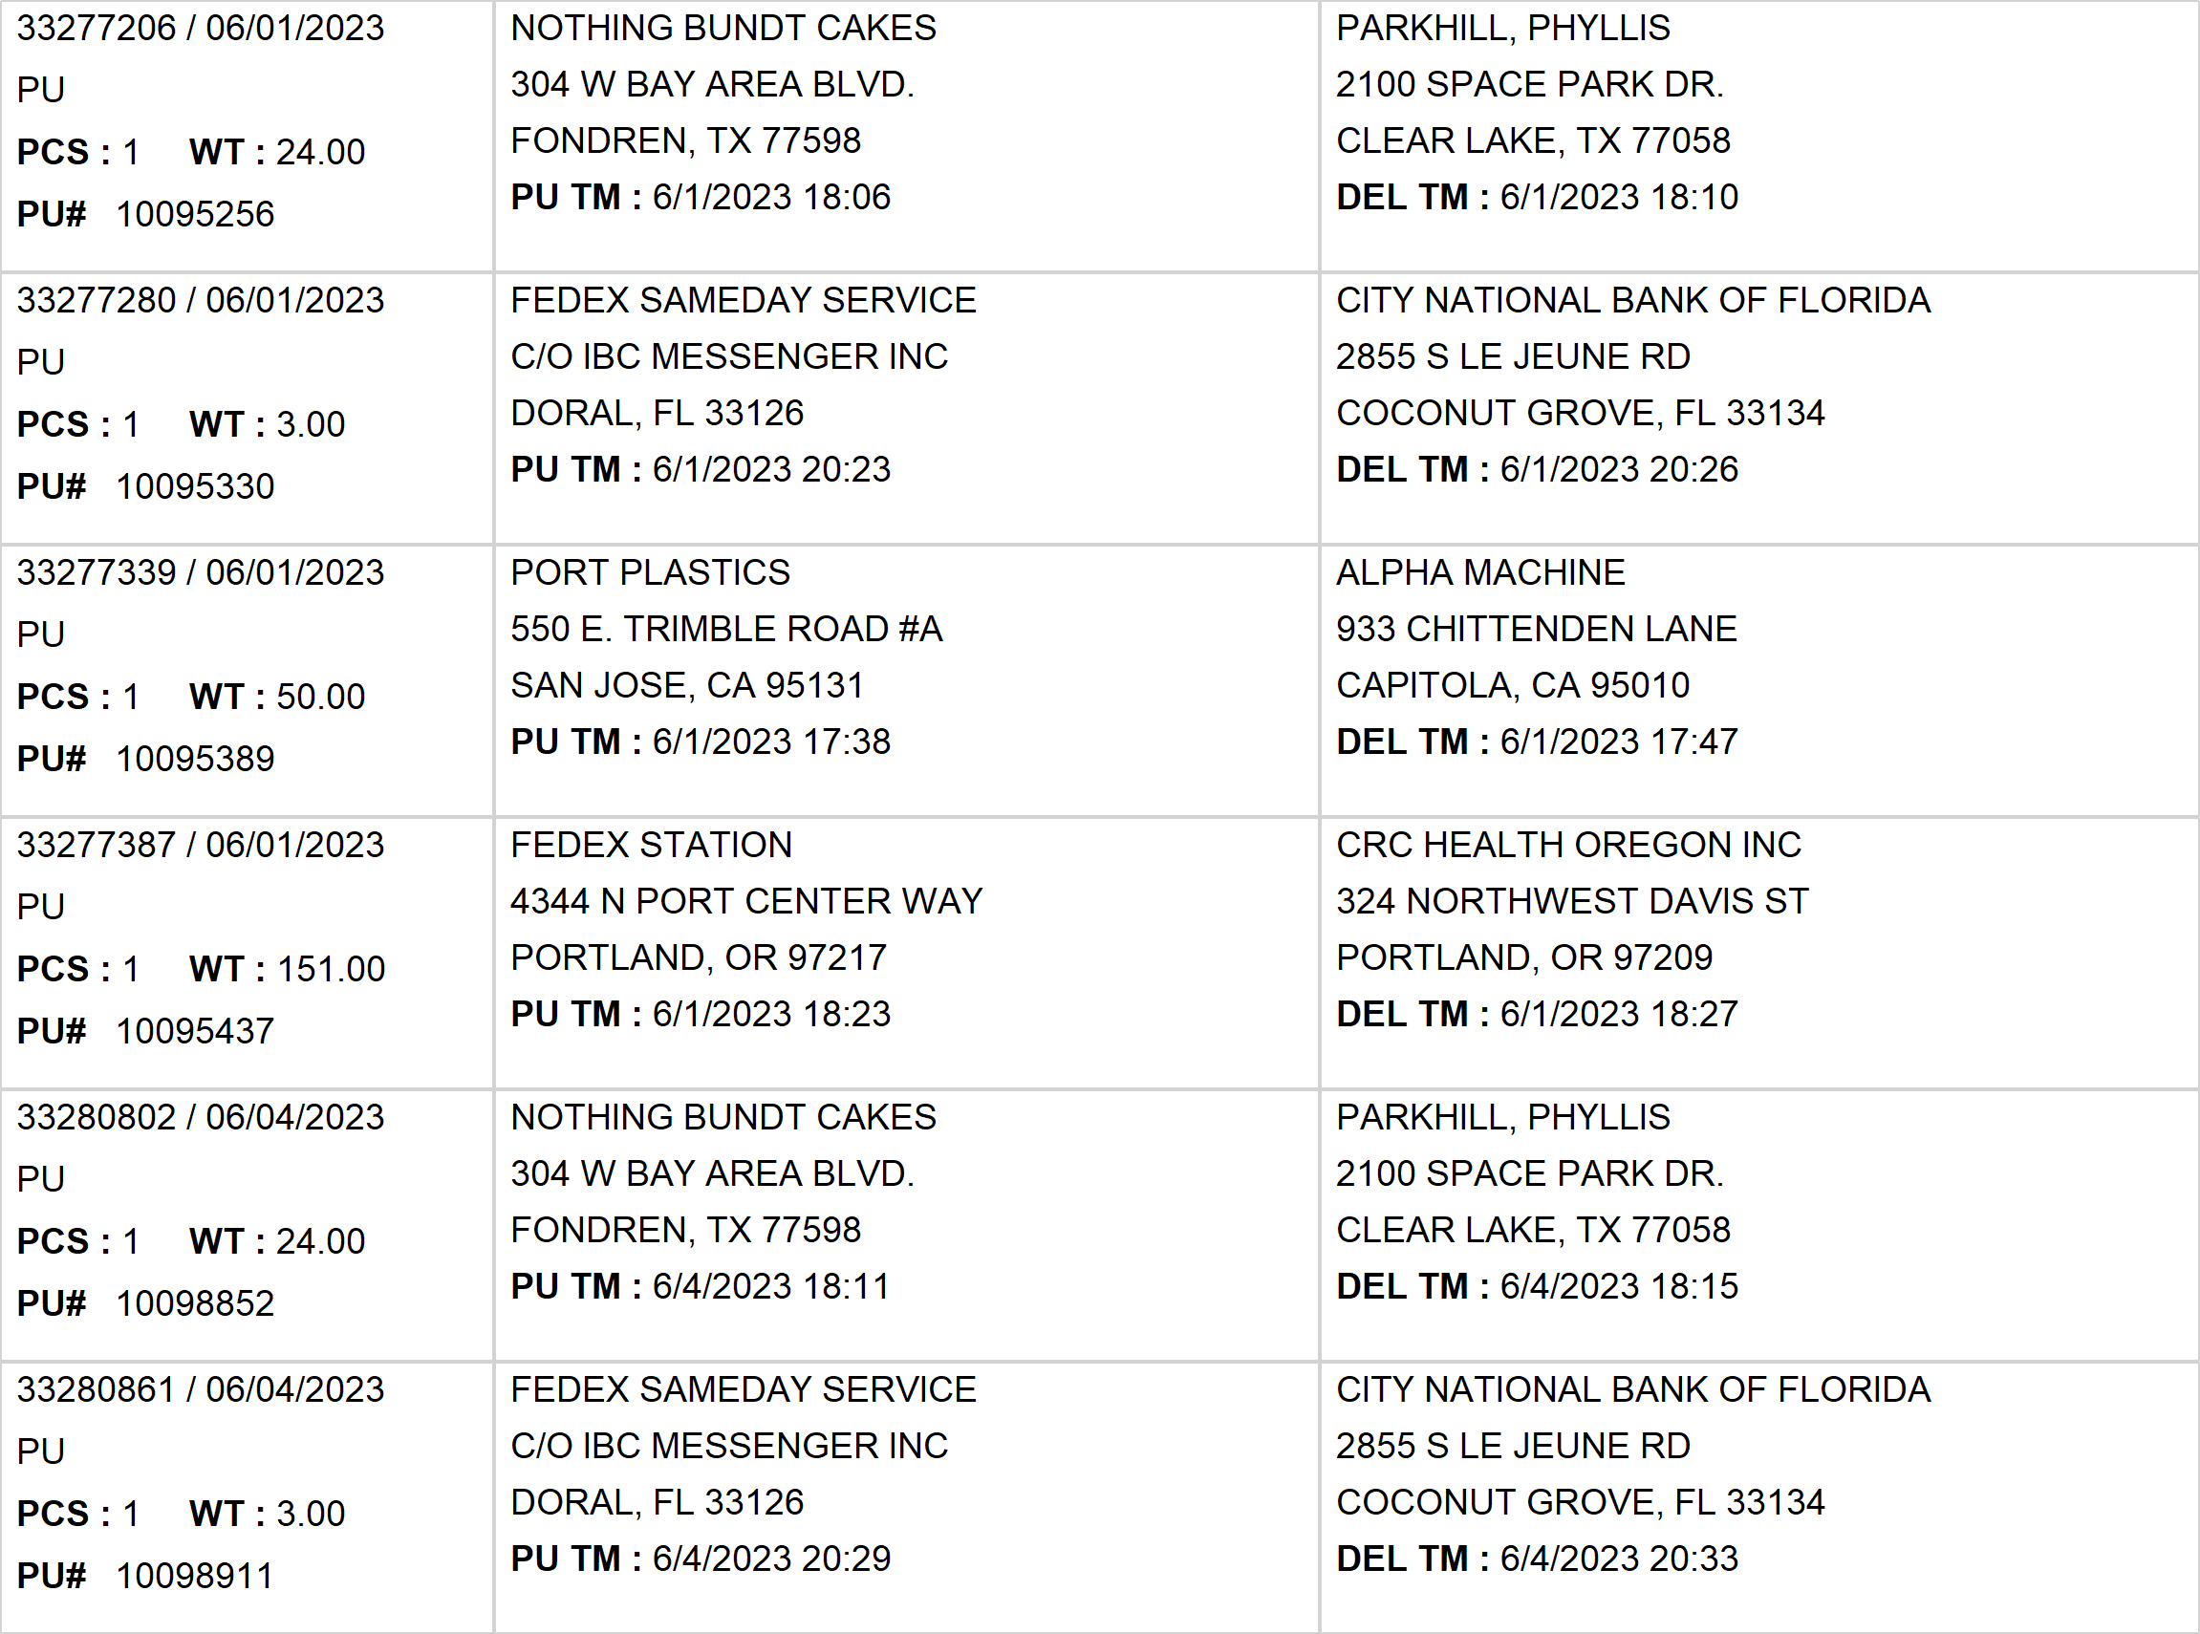
Agent Activity Report
*Data provided should be considered CONFIDENTIAL and PROPRIETARY*
©2011-2023 MNX Global Logistics. All rights reserved.
6/5/2023 2:47 AM
Print User : selenium.automation

Slide 15
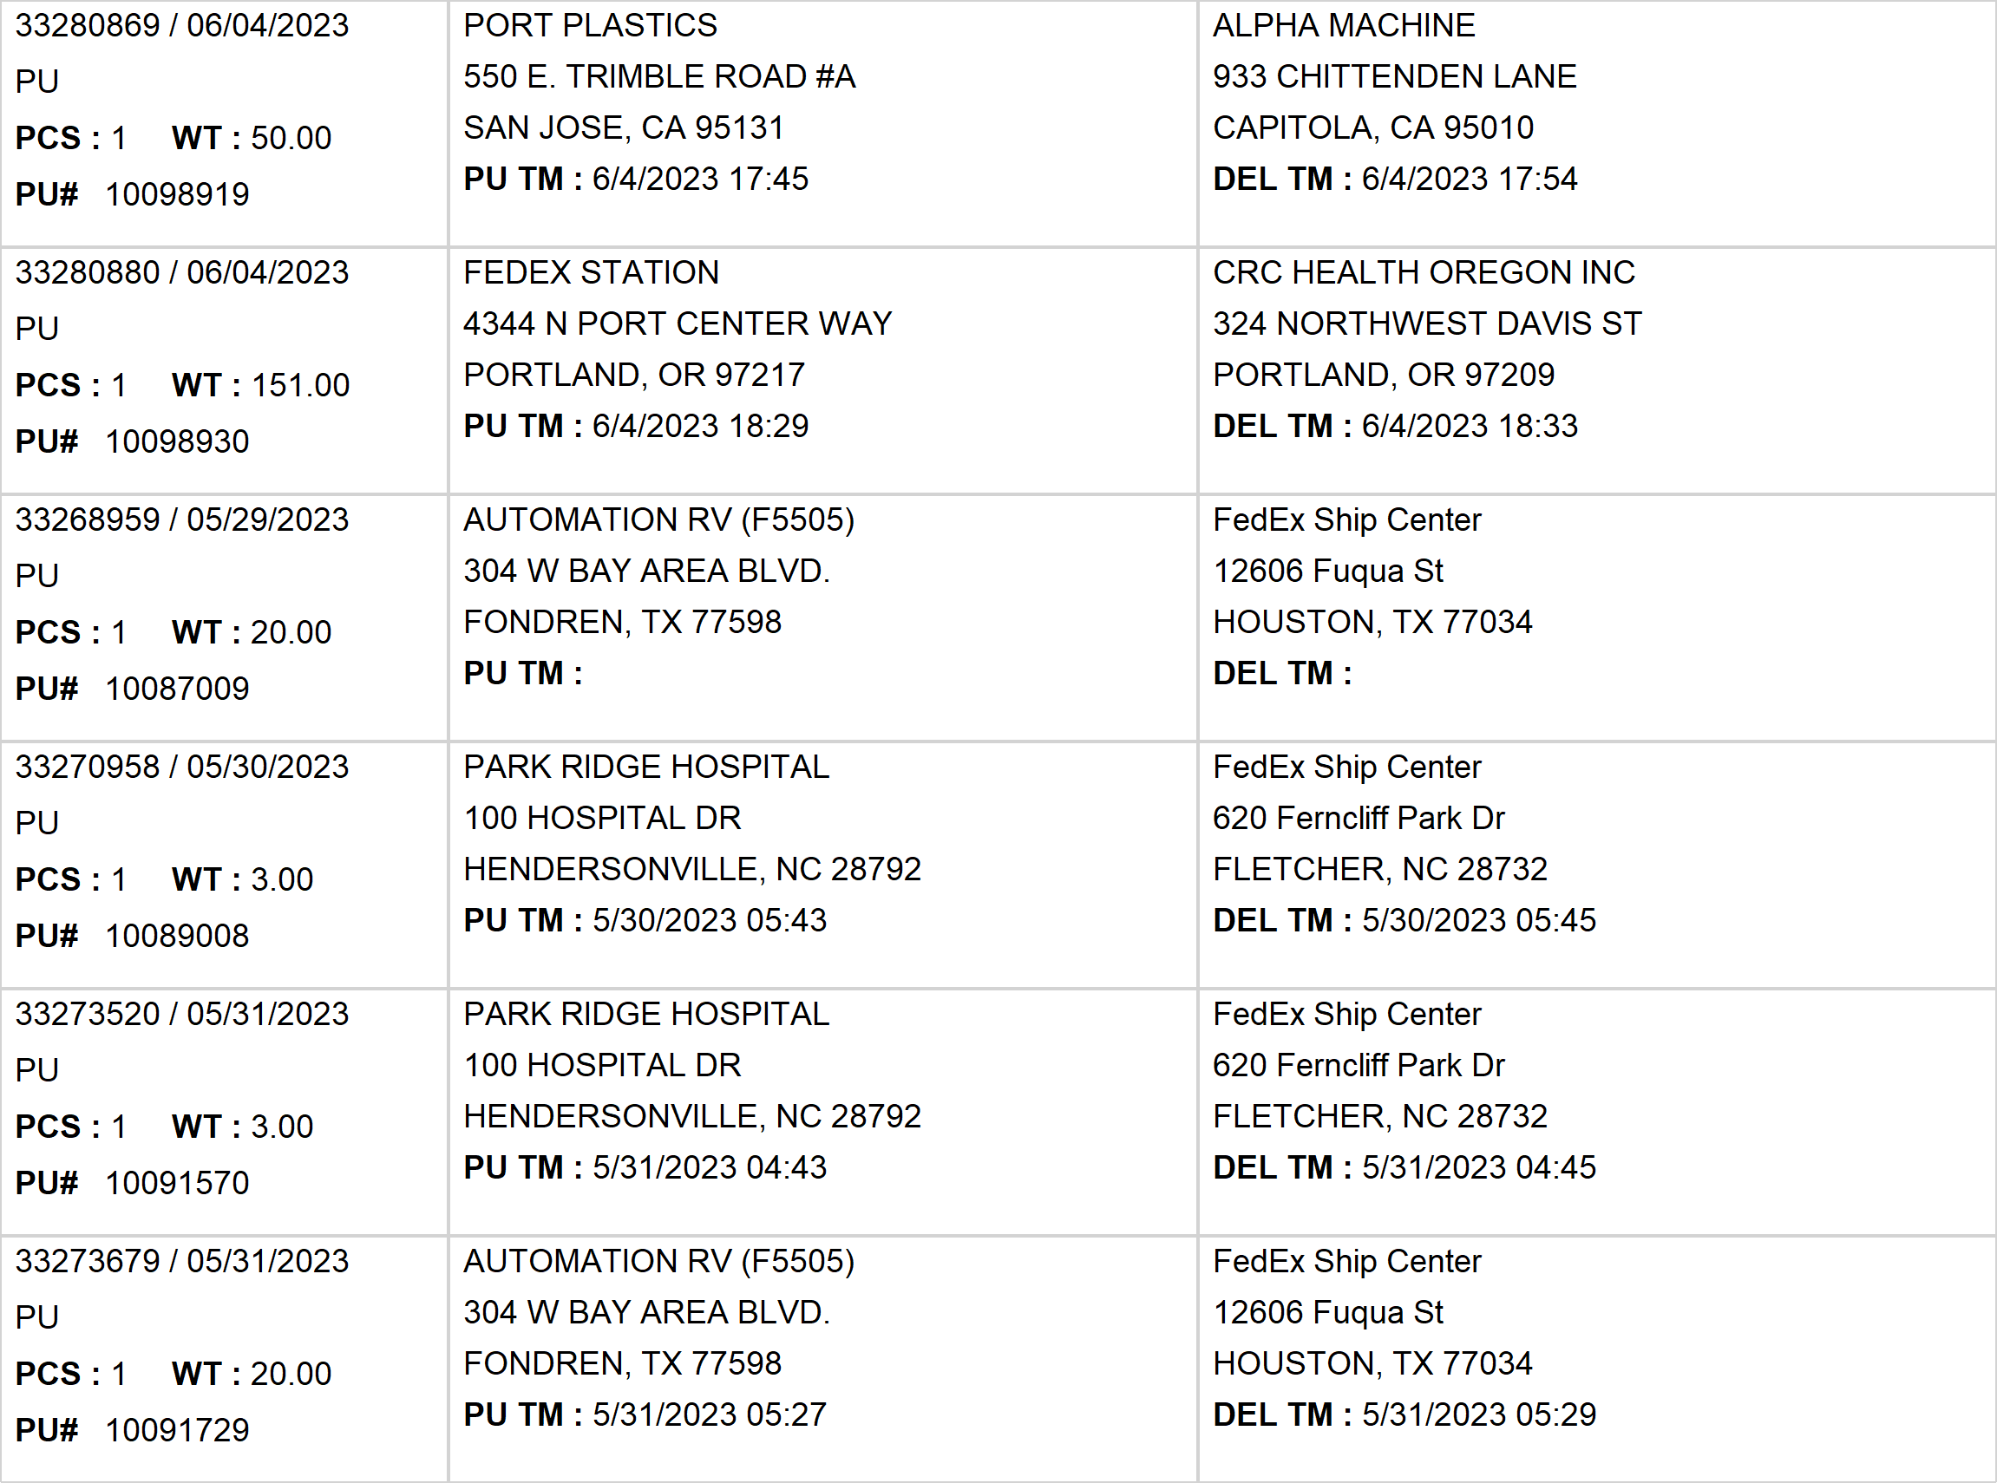
Agent Activity Report
*Data provided should be considered CONFIDENTIAL and PROPRIETARY*
©2011-2023 MNX Global Logistics. All rights reserved.
6/5/2023 2:47 AM
Print User : selenium.automation

Slide 16
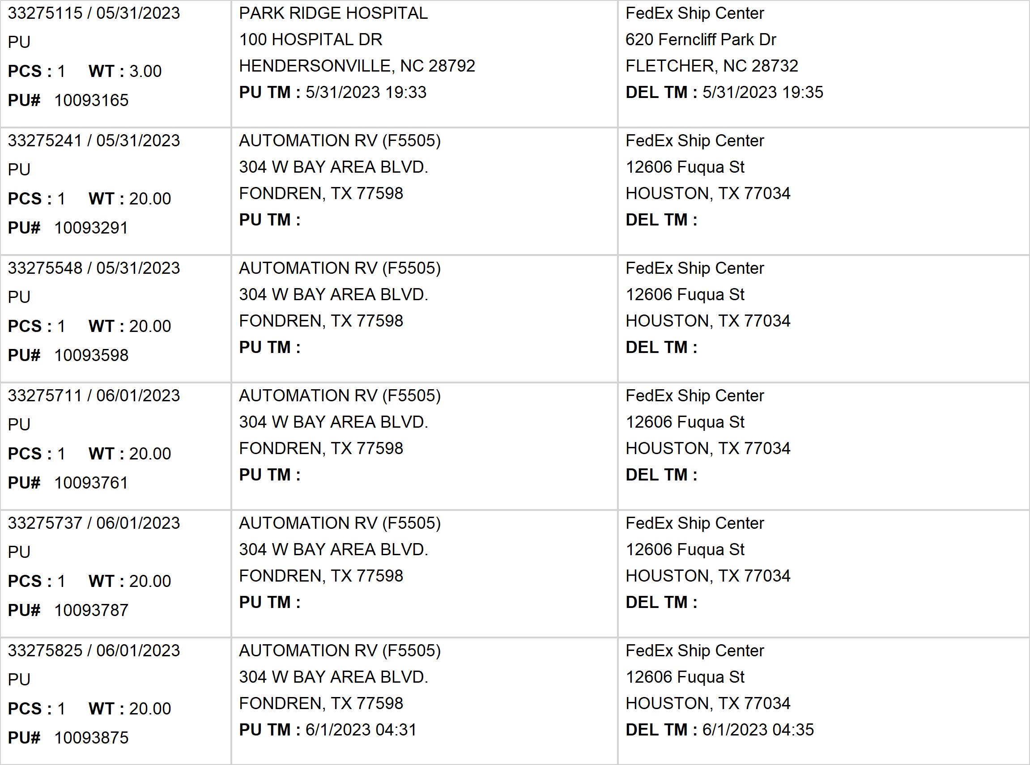
Agent Activity Report
*Data provided should be considered CONFIDENTIAL and PROPRIETARY*
©2011-2023 MNX Global Logistics. All rights reserved.
6/5/2023 2:47 AM
Print User : selenium.automation

Slide 17
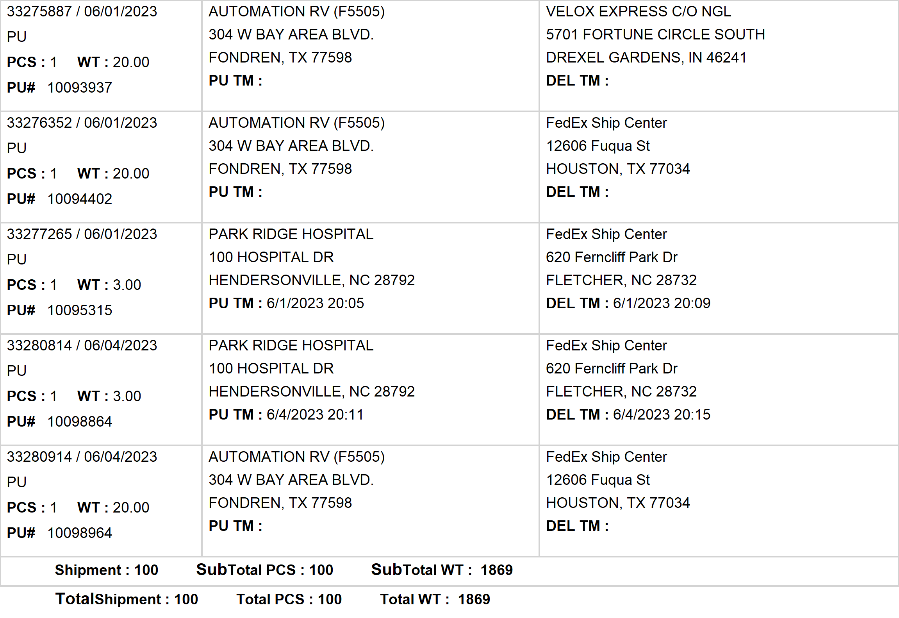
Agent Activity Report
*Data provided should be considered CONFIDENTIAL and PROPRIETARY*
©2011-2023 MNX Global Logistics. All rights reserved.
6/5/2023 2:47 AM
Print User : selenium.automation

